Slide 1
3 Types Of Cloud Service
Jack Pflug Quentin Bullock
Pamela Soulis

Slide 2
IaaS(Infrastructure as a service)
An IaaS provider will give you access to Servers and Networking firewalls on a pay as you go basis.
The main benefit of this service is the flexibility of the scaling. You don’t have to worry about unnecessary expenses and managing your own servers. You are responsible for maintaining your own software.
An example of an IaaS provider is Azure.
Real life example:
A development team is trying to test and deploy a new product ASAP(ie highly trafficked website). Services like azure allow the team to quickly scale up their servers(vertically and horizontally) without having to spend a lot of time.

Slide 3



PaaS (Platform As A Service)
Applications as input => Managed infrastructure as output.
PaaS provides a platform for software creation.
Customizing✅
Maintenance⛔
_
Example: Your buddy has the next great App idea.
Instead of needing a team of people to get an MVP out, they can learn javascript and deploy it from their garage on a Saturday.

Slide 4
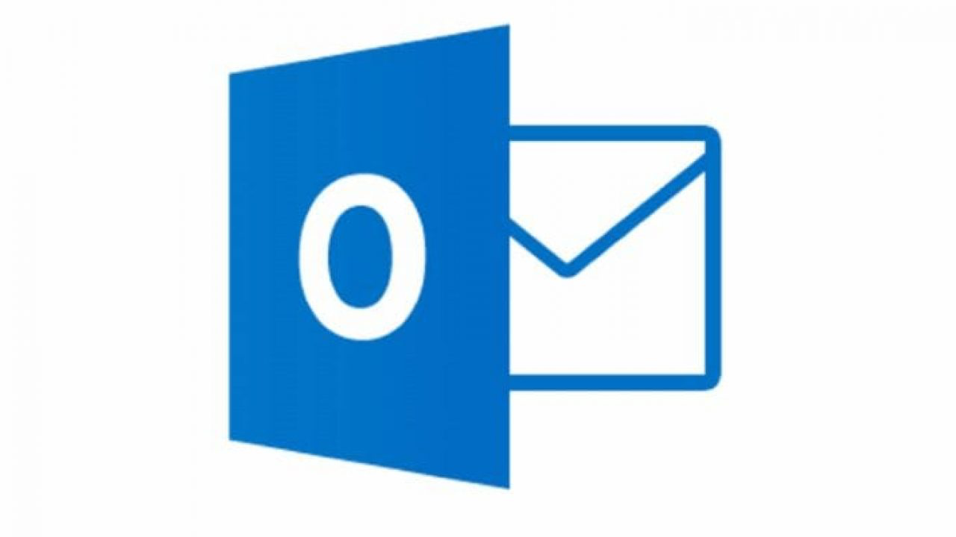
SaaS - Software as a Service
Saas sits on top of the cloud stack of services: users can connect to and use cloud-based apps over the internet
With SaaS, software can be quickly deployed, since it’s already installed on the cloud server
Less expensive and time consuming for companies to pay for software
Users pay for exactly what they need and don’t have to maintain the software
Example: An organization that lacks the resources to buy/deploy/maintain hardware and software can rent productivity apps (email, collaboration, calendaring) and business apps (CRM). The workforce then has access to SaaS apps from any device with Internet connection.
Public Cloud situation: software /infrastructure is owned and managed by cloud provider

